Slide 1
Master of Software Engineering
- Modern Financial Practices
软件工程硕士–现代金融业务
College of Software Technology at Ningbo, Zhejiang University
浙江大学软件学院宁波分院
Class 2 Fixed Income

Slide 2
Learning Objectives
Through this course the students will understand the fundamental concepts about Fixed Income Securities, Fixed Income Market and Trading flow. It will also help the students to learn how the Fixed Income market works in real world through examples and discussion. Homework and quiz will be given. Case study and project will also be part of the grading system.
Notes:
债权是金融工具的重要组成部分。在坐的同学是金融信息学院的软件工程硕士，相信大家毕业后有不少人会从事与金融相关的IT技术工作。
通过本次课程大家将会掌握有关固定收益证券的基础知识；同时了解证券市场的结构，交易流程，了解在现实世界中，固定收益市场是如何运作的。

Slide 3
Content
Session 1 Fixed Income Overview
1. Fixed Income Concept and Key Terminologies
2. Fixed Income Securities
Session 2 Fixed Income Market
3. Fixed Income Market Type and Characters
4. U.S. and China Fixed Income Market
5. Global Sub Prime Crisis
Session 3 Fixed Income Basic Pricing
5. Fixed Income Basic Pricing
6. Measure of Bond Price Volatility
Session 4 Fixed Income Trading
7. Fixed Income Trading Process
8. China and U.S. Fixed Income Trading
Notes:
本次课程分为以下几个部分
1.固定收益证券基础
2.固定收益市场
3.固定收益定价
4.固定收益证券交易

Slide 4
Session 1 Fixed Income Overview
Notes:
如何真正了解金融体系？
金融市场
- who
金融工具
-what
金融方法
-how

Slide 5
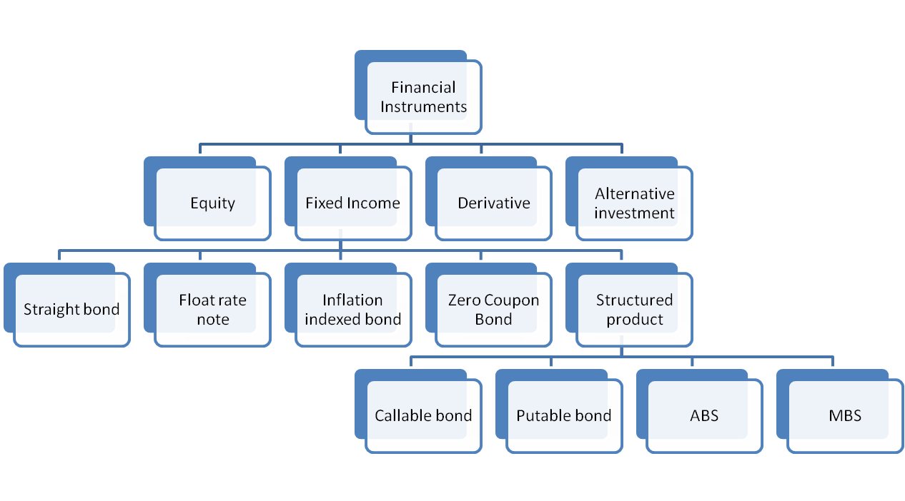
Where is bond?
Notes:
Callable bond可赎回债券，可回售债券，可买回债券；是指发行人有权在特定的时间按照某个价格强制从债券持有人手中将其赎回的债券，可视为是债券与看涨期权的结合体。
Putable bond可卖回债券可以认为是一种附带了看跌期权（put option）的债券，债券持有人可以按照特定价格在债券到期日之前强制卖给债券发行人。

Slide 6
The origination of bond
The “oldest” financial instrument
Dated back to 4 B.C (Treasury)
  To overcome financial difficulties (e.g.: WAR )
With the rise of capitalism
  Competition of colonization
  US independent WAR
  State Construction
Standardized
From in-kind to electronic
Notes:
在证券中，债券的历史比股票要悠久，其中最早的债券形式就是在奴隶制时代产生的公债券。据文献记载，希腊和罗马在公元前4世纪就开始出现国家向商人、高利贷者和寺院借债的情况。进入封建社会之后，公债就得到进一步的发展，许多封建主、帝王和共和国每当遇到财政困难、特别是发生战争时便发行公债。12世纪末期，在当时经济最发达的意大利城市佛罗伦萨，政府曾向金融业者募集公债。其后热那亚、威尼斯等城市相继仿效。
15世纪末16世纪初，美州新大陆被发现，欧洲和印度之间的航路开通，贸易进一步扩大。
为争夺海外市场而进行的战争使得荷兰、英国等竞相发行公债，筹措资金。在1600年设立的东印度公司，是历史上最古老的股份公司，它除了发行股票之外，还发行短期债券，并进行买卖交易。
美国在独立战争时期，也曾发行多种中期债券和临时债券，战争结束后，各类战争债、州政府债、社区债种类繁多，支付货币五花八门，整个金融市场一片混乱，1790年，33岁的财政部长亚历山大·汉密尔顿向国会递交了一份债务重组计划，宣布在1788年宪法通过之前美国发行的所有债务，包括联帮与地方政府发行的各种战争债、独立战争中军队签的各种借条，全部按原条款一分一文由联帮政府全额兑换。为了实现承诺，政府发行三只新债券，头两只债券年息6%（一只于1791年开始付息，另一只于1801年才付息），第三只债券只付息3%，简化了新国家的债务局面，在随后这些债券与次年推出的“美国银行”股票的发行和交易便形成了美国最初的证券市场。债券市场起源于战争融资需要，先于其他证券市场发展。
19世纪30年代后，美国各州大量发行州际债券。19世纪40—50年代由政府担保的铁路债券迅速增长，有力地推动了美国的铁路建设。19世纪末到20世纪，欧美资本主义各国相继进入垄断阶段，为确保原料来源和产品市场，建立和巩固殖民统治，加速资本的积聚和集中，股份公司发行大量的公司债，并不断创造出新的债券种类，这样就组建形成了今天多品种、多样化的债券体系。

Slide 7
Bond Features
A bond is a debt security, in which the authorized issuer owes the holders a debt and, depending on the terms of the bond, is obliged to pay interest (the coupon) and/or to repay the principal at a later date, termed maturity. A bond is a formal contract to repay borrowed money with interest at fixed intervals.
Bond Parties
  The Issuer Who Is Borrowing Money
  The Investors Who Lend the Money
Maturity and Coupon
  Has a Maturity, such as 20 Years
  Specifies Interest Payments
Par Value or Face Value
  Is a Small Part of the Overall Loan, such as $1,000.
  Is Easily Traded in the Bond Market
Notes:
依照法定程序发行，约定在一定期限内还本付息的有价证券。债券是国家或地区政府、金融机构、企业等机构直接向社会借债筹措资金时，向投资者发行，并且承诺按特定利率支付利息并按约定条件偿还本金的债权债务凭证
债券的本质：未来获取现金流的权利

Slide 8
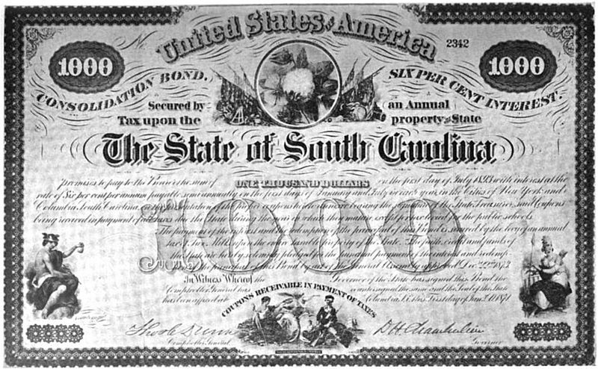
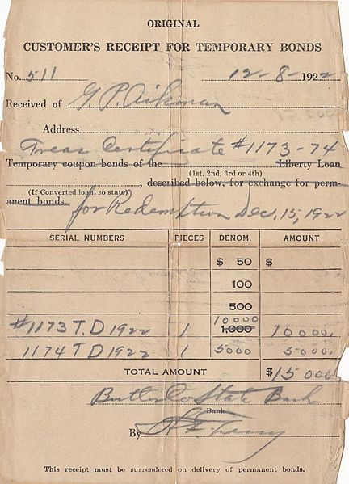

In-Kind bond
Notes:
Bond certificate for the state of South Carolina issued in 1873 under the state's Consolidation Act.
Receipt for temporary bonds for the state of Kansas issued in 1922
国库券

Slide 9
Electronic Bond
Issuer Name | Coupon | Maturity | Rating | High | Low | Last | Change | Yield %
 |  |  | Moody's/S&P/
 |  |  | Fitch
MORGAN STANLEY | 5.750% | Oct 2016 | Aa3/A+/AA- | 104.750 | 102.400 | 102.496 | 0.145 | 5.418
DAIMLERCHRYSLER N.A. HLD CORP | 5.750% | Sep 2011 | Baa1/BBB/BBB+ | 100.645 | 100.241 | 100.241 | -0.103 | 5.689
HSBC HLDS PLC | 6.500% | May 2036 | Aa3/A+/AA- | 110.401 | 109.253 | 110.247 | 1.560 | 5.771
DIAGEO CAPITAL PLC | 5.125% | Jan 2012 | A3/A-/A+ | 99.675 | 99.617 | 99.675 | 0.159 | 5.188
WEYERHAEUSER | 6.750% | Mar 2012 | Baa2/BBB/BBB | 106.660 | 105.122 | 105.512 | 0.184 | 5.521
TELEFONOS DE MEXICO SA DE CV | 5.500% | Jan 2015 | A3/BBB+/A- | 98.720 | 98.570 | 98.720 | 0.040 | 5.698
Notes:
而今，债券演化为了电子形式的

Slide 10
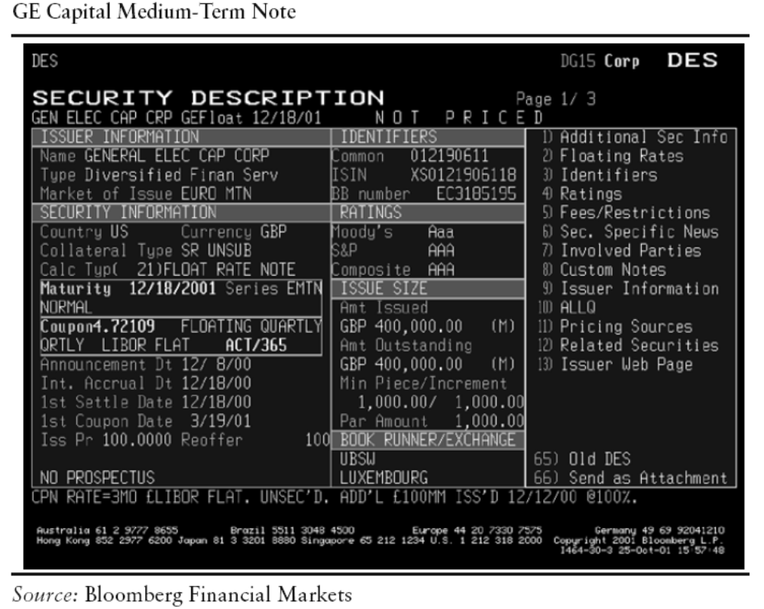
Bond Example

Slide 11
China Bond Example
债券代码 | 债券简称 | 债券发行日 | 本次付息起息日 | 上次派息日 | 预计下次派息日 | 兑付日 | 票面利率(%)
010115 | 21国债(15) | 2001-12-18 | 2005-12-18 | 2005-12-19 | 2006-12-18 | 2008-12-18 | 3.000
010203 | 02国债(3) | 2002-04-18 | 2006-04-18 | 2006-04-18 | 2007-04-18 | 2012-04-18 | 2.540
010210 | 02国债(10) | 2002-08-16 | 2005-08-16 | 2005-08-16 | 2006-08-16 | 2009-08-16 | 2.390
010213 | 02国债(13) | 2002-09-20 | 2006-03-20 | 2006-03-20 | 2006-09-20 | 2017-09-20 | 2.600
010214 | 02国债(14) | 2002-10-24 | 2005-10-24 | 2005-10-24 | 2006-10-24 | 2007-10-24 | 2.650
010215 | 02国债(15) | 2002-12-06 | 2005-12-06 | 2005-12-06 | 2006-12-06 | 2009-12-06 | 2.930
010301 | 03国债(1) | 2003-02-19 | 2006-02-19 | 2006-02-20 | 2007-02-19 | 2010-02-19 | 2.660
010303 | 03国债(3) | 2003-04-17 | 2006-04-17 | 2006-04-17 | 2006-10-17 | 2023-04-17 | 3.400
010307 | 03国债(7) | 2003-08-20 | 2005-08-20 | 2005-08-22 | 2006-08-20 | 2010-08-20 | 2.660

Slide 12
China Bond Example
债券基本资料
债券名称 | 2005年第三期中央银行票据 | 基本利差(%) | 0
债券简称 | 05央行票据03 | 基础利率(%) | 0
债券代码 | 0501003 | 划款日 | 2005-01-07
发行日期 | 2005-01-06 | 起息日 | 2005-01-07
债券期限(年/月/日) | 3年 | 到期日 | 2008-01-07
计划发行总额(亿元) | 150.00 | 流通状态 | 可流通
实际发行总额(亿元) | 150.00 | 上市流通日 | 2005-01-07
发行人简称 | 人总行 | 发行手续费率(%) | 0
债券性质 | 央行票据 | 流通场所 | 银行间债券市场
选择权 |  | 首次发行范围 | 银行间债券市场
本息状态 |  | 首次发行价格 | 100.000
付息频率(月) | 12 | 计息方式 | 附息式固定利率
票面利率(%) | 4.150 | 兑付手续费率(%) | 0
Source:中国债券信息网

Slide 13
China Corporate Bond Example
债券名称 | 桂冠转债
债券代码 | 100236
期限 | 5年
当前年限 | 年
面值 | 100元
发行量 | 7.71亿
利率 | 2.1%
发债种类
发债主体 | 广西桂冠电力股份有限公司
主承销商 | 华夏证券股份有限公司
信用评级: | AAA-
国债付息方式 | 按年付息
上市日 | 2003-07-15
开始发行日 | 2003-06-30
发行截至日
摘牌日
到期日 | 2008-06-29
到期本息和

Slide 14
Overview of Bond Features
Type of Issues – federal government, agencies, municipal government, and corporations.
Par Value – also know as “face value” which is the value return to the investor when the bond matures.
  bonds often trade above or below par. Buying below par is a discount, above par is premium.
Coupon rate – Interest rate that the bond issuer promises to pay to the bondholder.
  Fixed coupon bond,
  Zero-coupon bond,
  Floating-rate bonds (reference rate + quoted margin) : 3 month Libor(伦敦同业拆借利率) + 20 Basic Points
Term to Maturity – Due date of the bond for repayment.
  Short term: bond with a maturity of between one and five years.
  Intermediate term: bond with a maturity between five and 12 years.
  Long term: bond with a maturity more than 12 years.
Notes:
让我们来看，债券的主要特征
首先发行人
面值
票息
到期日
municipal government市政府

Slide 15
Overview of Bond Features
Amortization Feature – The principal repayment of a bond issue can call for the principal repaid over the life of the bond.
  Amortization Schedule: automobile loan and home mortgage loan.
Embedded Options
  Call provision – the issuer has right to retire the debt, fully or partially, before maturity.
  Put provision – the bondholder has the right to sell the issue back to the issuer at par value on designated dates.
  Convertible bond – the bondholder has right to exchange the bond for a specified number of shares of common stock.
  Exchangeable bond – bondholder to exchange the issue for a specified number of common stock shares of a corporate different from the issuer of bond.
Notes:
摊销特征
汽车贷款
住房贷款
是否含权
-提前兑回条款
-提前卖回条款
-可转换条款
-可交换债券

Slide 16
Risks association with bonds
Interest Rate Risk
Reinvestment Risk
Call Risk
Credit Risk
Inflation Risk
Exchange-Rate Risk
Liquidity Risk
Volatility Risk
Notes:
投资债券风险
-利率风险。
-再投资风险。持有到期收益
-提前赎回风险
-信用风险
-通货膨胀风险
-汇率风险
-流动性风险

Slide 17
Fixed Income Securities
Treasury(Sovereign) securities U.S. Treasury securities, U.K. gilts, German government bonds( Bunds), Japanese government bonds(JGBs), French government bonds(OATs)
Agency securities government agencies, such as the Federal Home Loan Bank(FHLB) and the Tennessee Valley Authority(TVA), Federal National Mortgage Association(FNMA), and Government National Mortgage Association(GNMA).
Corporate securities
Mortgage-backed securities
Asset-backed securities
Municipal issues
Emerging market securities
Notes:
按照发行人：
国债
机构债
大萧条(Great Depression)时，联邦政府进行的计划中，最着名且最成功的一项是田纳西河谷管理局或简称TVA。您知道这个计划的内容及为什么要进行这个计划原因吗？
公司债
住房抵押贷款证券
资产抵押证券
市政债券
新兴市场证券

Slide 18
U.S. Treasury Securities
Issued by the U.S. Department of the Treasury and are backed by the full faith and credit of the U.S. government. Market participants view them as having no credit risk.
Interest rates on Treasury securities are benchmark interest rates throughout the U.S. economy.
Two factors : volume and liquidity.
Types of Treasury Securities
  Fixed-principal securities: Treasury bills, Treasury notes and Treasury bonds.
  Inflation-Indexed securities, also Treasury inflation protection securities (TIPS)
Stripped Treasury Securities
  STRIPS program.
  The zero-coupon Treasury securities created under the STRIPS program.
Notes:
由财政部发行，美国政府信用做担保
基准利率
发行量大，流动性好
公开市场工具，美元发行
T-bills are short-term obligations issued with a term of one year or less, and because they are sold at a discount from face value, they do not pay interest before maturity. The interest is the difference between the purchase price and the price paid either at maturity (face value) or the price of the bill if sold prior to maturity.
Treasury notes and bonds, on the other hand, are securities that have a stated interest rate that is paid semi-annually until maturity. What makes notes and bonds different are the terms to maturity. Notes are issued in two-, three-, five- and 10-year terms. Conversely, bonds are long-term investments with terms of more than 10 years.
本息分离债券
本金分离债券和利息分离债券，前者受非美国投资者青睐因为资本利得税很低或免税

Slide 19
Treasury Inflation Protection Securities
Inflation adjusted principal, for example:
A TIPS, coupon rate is 3.5%, annual inflation is 3%. An investor purchases on Jan 1 $100,000 par value of this issue.
The semiannual inflation rate is 1.5%.
The inflation-adjusted principal at the end of the first six-month period is
$100,000 * (1 + 1.5%) = $101,500.
The coupon payment is 101,500 * 1.75% = $1,776.25
An inflation-adjusted principal is defined in terms of the ratio of the reference CPI.
Notes:
通胀保护国债TIPS
意图：保护债券持有人免受通胀带来的固定利息收入贬值的损失
息票利率依赖：城市居民消费者价格指数衡量的通胀率

Slide 20
Sovereign Bond
Canadian Debt Market
  Maturity range – 2 to 30 years; 5 to 10 years most liquid; OTC dealer network; Benchmark – 3,5, and 10 years
U.K. government bonds (gilts)
  OTC, Fixed, annual coupons; Coupon payments called dividends
Japanese Government Bond(JGB)
  Classified into Construction bonds, Deficit Financing bonds, and Refinancing bonds.
  Market organization – trades in Tokyo Stock Exchange
German government bonds
  Typically 10 years
  Market Organization – stock exchanges and OTC dealer market
Notes:
主权债券

Slide 21
Corporate Securities
Corporate Bond Instruments:
  Corporate bond
  Medium-term notes
  Commercial paper
  Asset-backed securities
Corporate Bond
  Investment Grade
  High-Yield Debt
  Junk debt垃圾债
Notes:
An asset-backed security is a security whose value and income payments are derived from and collateralized (or "backed") by a specified pool of underlying assets. The pool of assets is typically a group of small and illiquid assets that are unable to be sold individually. Pooling the assets into financial instruments allows them to be sold to general investors, a process called securitization, and allows the risk of investing in the underlying assets to be diversified because each security will represent a fraction of the total value of the diverse pool of underlying assets. The pools of underlying assets can include common payments from credit cards, auto loans, and mortgage loans, to esoteric cash flows from aircraft leases, royalty payments and movie revenues.
投资级：标普BBB以上，投资级，4.64%违约率 ，再下一级就有20%违约率
高收益债：标普BBB以下，也叫垃圾债（Junk Bond）。垃圾债券之王 迈克尔-米尔肯

Slide 22
Retirement Methods
Redemption at Maturity
Earlier Redemption through a “Call”
  Interest Rates Have Declined and Issuer Wants to Refinance
Refunding Funds
  Replace an old bond issue with a new one, often at a lower interest cost.
Scheduled payment
  Principle paid periodically
Sinking Funds paid
  a Plan to Retire A Portion of the Outstanding Bonds Each Year
Conversion to Common Stock
  Convertible Bonds
Notes:
偿还方法：
到期偿还
提前偿还
偿债基金条款
偿债基金
为确保债券能干到期日有足够的资金以偿还债权人的本金，发行公司于债券未到期前预先按期提存的基金。偿债基金通常是存入选定的一家银行作为信托管理人，由信托管理人利用这笔基金进行各种投资，投资收益则增加偿债基金。由此可见，偿债基金相当于一笔专用基金存款。由于偿债基金不在债券发行公司掌握中，其性质是由受托人管理的公司债券持有人的资金，但在实际偿还本金之前，并不抵消债券发行公司的债务。
债券发行公司应按券契约的规定提存偿债，每年提存偿债基金的终值应等于债券的本金。每年年终应根据信托管理人关于偿债基金的收支报告，确认应有投资收益或投资损失。如果偿债基金不足以清偿券本金，则就首先从一般存款户补足，然后作清偿全部公司债的会计处理。公司偿债基金应作为一项长期投资反映在年末资产负债表上，偿债基金投资收益或损失则应作为其他项目列入当年的损益表。
定期付款
转换

Slide 23
Credit Assessment
Most corporate bonds are given a credit rating by S&P, and Moody and Fitch Rating Service.
Bonds rated BBB or higher by S&P, Baa or higher by moody’s, are considered investment-grade bonds.
Bonds rated below these levels are considered to be high yield bonds.
Notes:
信用评价：标普，穆迪，惠誉评级

Slide 24
Corporate Bond Rating
Moody’s S&P Fitch Brief Definition
Aaa AAA AAA Gilt edge, prime, maximum safety
Aa1 AA+ AA+
Aa2 AA AA Very high grade, high quality
Aa3 AA- AA-
A1 A+ A+
A2 A A Upper medium grade
A3 A- A-
Baa1 BBB+ BBB+
Baa2 BBB BBB Lower medium grade
Baa3 BBB- BBB-
Ba1 BB+ BB+
Ba2 BB BB
Ba3 BB- BB-
B1 B+ B+
B2 B B
B3 B- B-
Notes:
16等级
BBB-以上，投资级，4.64%违约率 ，再下一级就有20%违约率

Slide 25
Risk of Corporate Bonds
Credit Risk
  Default Risk
  Downgrade Risk
Liquidity Risk
Economic Risk
Interest Rate Risk
Notes:
公司债的风险：
信用：违约风险，降级风险
流动性风险
In financing a project, the risk that the project's output will not generate sufficient revenues to cover operating costs and to repay debt obligations.
利率风险

Slide 26
Municipal Securities
Municipal securities are issued by state and local governments.
Most municipal bonds outstanding are tax-exempt for interest payments.
Types and Features of Municipal Securities
  General Obligation Bonds is secured by the issuer’s unlimited taxing power
  Revenue Bonds is secured by the revenue of issuers, such as Airport Revenue Bonds, University Revenue Bonds, Hospital Revenue Bonds, Public Power Revenue Bonds.
Notes:
市政债券/地方政府债
- 一般责任债券，税收做后盾
另一种市政债券称为“收入债券”(revenue bonds)，用于为特定项目(如收费公路)融资，以项目的收入来偿还本息。
市政债券是美国各州、郡、特区、市、镇政府机构或学校发行的债券，其利息一般免征联邦所得税。

Slide 27
Asset-Backed Securities
Asset-backed securities(ABS) are bonds or notes collateralized by the cash flows from a specified pool of underlying assets.
The financial institutions that originate the loans sell a pool of cash-flow-producing assets to a specially created third party that is called a special-purpose vehicle (SPV). The SPV sells the pools loans to a trust, which issues interest-bearing securities that can achieve a credit rating separate from the financial institution that originates the loan.
Notes:
资产支持证券，抵押资产的现金流
资产支持证券就是由特定目的信托受托机构发行的、代表特定目的信托的信托受益权份额。受托机构以信托财产 为限向投资机构承担支付资产支持证券收益的义务。

Slide 28
Types of Asset-Backed Securities
Home Equity Loans
Autos
Credit Cards
Student Loans
Can be any kind of asset generating cashflow

Slide 29
Credit Quality and Enhancement
Most ABS are rated either AAA or AA.
Credit Enhancement:
  Excess Spread
  Over Collateralization
  Reserve Account
  Surety Bonds
  Wrapped Securities
  Letter of Credit
  Cash Collateral Account
Notes:
信用增级
Credit enhancement is a key part of the securitization transaction in structured finance, and is important for credit rating agencies when rating a securitization. The credit crisis of 2007-2008 has discredited the process of credit enhancement of structured securities as a financial practice as the risk was not assessed correctly and defaults began to rise. If the credit rating was properly assessed and higher interest rates assigned to structured securities, then the crisis may have been averted.
1. Internal credit enhancement内部增信
Excess spread 超额利差
The excess spread is the difference between the interest rate received on the underlying collateral and the coupon on the issued security. It is typically one of the first defenses against loss. Even if some of the underlying loan payments are late or default, the coupon payment can still be made. In the process of "turboing", excess spread is applied to outstanding classes as principal.[
Overcollateralization
Overcollateralization (OC) is a commonly used form of credit enhancement. With this support structure, the face value of the underlying loan portfolio is larger than the security it backs, thus the issued security is overcollateralized. In this manner, even if some of the payments from the underlying loans are late or default, principal and interest payments on the asset-backed security (ABS) can still be made.
Reserve account坏账准备金
A reserve account is created to reimburse the issuing trust for losses up to the amount allocated for the reserve.
2. External credit enhancement
Surety bonds 确实保证保险
are insurance policies that reimburse the ABS for any losses. They are external forms of credit enhancement. ABS paired with surety bonds have ratings that are the same as that of the surety bond’s issuer
Wrapped securities
A wrapped security is insured or guaranteed by a third party. A third party or, in some cases, the parent company of the ABS issuer may provide a promise to reimburse the trust for losses up to a specified amount. Deals can also include agreements to advance principal and interest or to buy back any defaulted loans.
Letter of credit信用证
With a letter of credit (LOC), a financial institution — usually a bank — is paid a fee to provide a specified cash amount to reimburse the ABS-issuing trust for any cash shortfalls from the collateral, up to the required credit support amount.
Cash collateral account现金担保账户
With a cash collateral account (CCA), credit enhancement is achieved when the issuer borrows the required credit support amount from a commercial bank and then deposits this cash in short-term commercial paper that has the highest available credit quality.

Slide 30
Mortgage Backed Securities
A MBS is an instrument whose cash flow depends on the cash flows of an underlying pool of mortgages such as the purchase of homes or other real estate.
Three types of MBS:
  Mortgage pass-through securities
  Collateralized Mortgage obligations
  Stripped mortgage-backed securities
Key Associations
  Government National Mortgage Association (GNMA) backed by the National Housing Act 1970 – Ginnie Mac
  Federal National Mortgage Association (FNMA) - Fannie Mae (房利美)
  Federal Home Loan Mortgage Corporation (FHLMC) – Freddie Mac (房地美)
Notes:
住房抵押贷款证券
- 住房抵押转手证券
担保抵押贷款证券 (Trench; credit trench, equity trench)
剥息抵押证券,利息和本金剥离

Slide 31
Types of Mortgage-Backed Securities
Pass-through securities
  The bondholder normally receives some portion of the bond’s principal and interest back each month, and may receive additional cash flow from prepayments.
Collateralized Mortgage Obligations (CMOs)
  Allow for the creation of bonds with a wide range of risk and return characteristics.
  Sequentials
  PACs (Planned Amortization Class)
  TACs (Targeted Amortization Class)
Stripped Mortgage-back securities

Slide 32
Concept of Securitization
Originator 1
Pool of mortgages
Originator 2
Credit and liquidity
enhancements(guarantees)
Originator 3
Special Purpose
Vehicle
Credit rating agencies
(issuance of high credit)
MBS
Financial
Intermediaries
Institutional and
retial Investors

Slide 33
Session 2 Fixed Income Market

Slide 34
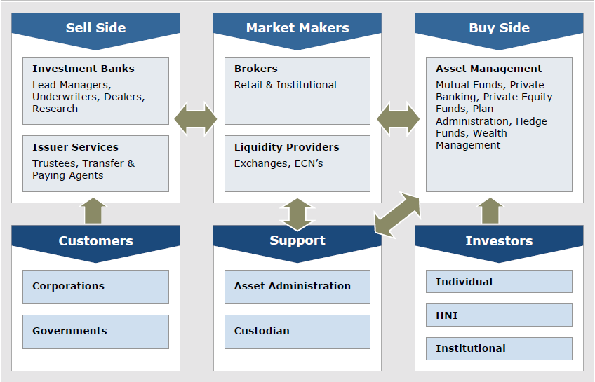
Market Structure Overview
Notes:
金融市场的宏观结构图

Slide 35
The Player in Bond Market
Issuer of Bond Securities
Financial Intermediaries
Institution and Retail
Investors
Issuer:
Government and Agency
Corporate
Commercial Bank
States
Special-purpose Vehicals
Foreign Institutions
Issuer:
Primary Dealers
Other Dealers
Investment Bank
Credit Rate Agencies
Credit and liquidity
enhancer
Investors:
Government
Pension fund
Insurance companies
Mutual fund
Commercial Bank
Household

Slide 36
Fixed Income Market Type
Money market
  defined as the market for financial assets that have original maturities of one year or less.
Bond market
  Is as the market for fixed income security that have maturities of more than one year.
Notes:
货币市场是短期资金融通的市场，资金的借贷期为一年以内。期限短、流通性强、交易成本低和风险低。做银行承兑汇票、商业票据、回购协议、可转让存款证以及国库券。
债券市场是发行和买卖债券的场所。期限长，收益较高，流通性弱，交易成本相对较大和风险性相对较大。做政府债券（国债）、金融债券、企业债券

Slide 37
Fixed Income Market
From issuers perspective, we can get six sectors:
Government sector
  Include Treasury bills, notes, and bonds, plays a key role in the valuation of securities and the determination of interest rates.
Agency sector
Municipal sector
  State and local government issue bonds.
Corporate sector
Asset-Backed sector
Mortgage Sector

Slide 38
Market Organization
Direct Search (直接交易市场)
  An arrangement in which buyers directly search and identify matching sellers without the benefit of one or more intermediaries.
Brokered Market (经纪市场)
  When trading becomes more and more frequent, brokers may find it economical to intermediate ( for a fee) and match buyers and sellers at mutually agreed-upon terms.
Dealer Market (交易商市场)
  Dealers may quote different bid-offer prices from the same security.
  Dealers, unlike brokers, also take outright positions in securities.
  Dealers are also exposed to the market risk on their inventories.
Auction Market (拍卖市场)
  Centralized markets in which all market participants interact simultaneously
Notes:
组织程度最低的市场。购买者和出售者必须直接寻找到对方。

Slide 39
U.S. Treasury Market
Maturities ranging from a few days to 30 years.
The Treasury securities are auctioned by the U.S. Treasury frequently. (Buyback)
On-the-run issues & Off-the-run issues
Their prices are quoted in fractions of 1/32,1/64. (1/32 is referred to as a tick)
The flat price(the quoted price) plus the accrued interest is known as the full price or the invoice price.
Benchmark Maturities – 3m,6m,1Y,2Y,5Y,10Y,30Y
Notes:
Off-the-Run Issue 非指标债券,
On-the-Run Issue 指标债券.指某种年期债券最新发行的一批，相当于该年期的指标债。

Slide 40
Corporate Bond Market
Two key differences between the Treasury and corporate market
  Credit risk
    Moody’s, Standard & Poors, and Fitch.
  Smaller issues
    A typical corporate issue is of the order of $100 million to $200 million, whereas a typical Treasury auction is of the order of $10 billion to $12 billion.
Key corporate securities
  Price the new issues
  Arrange the distribution
  Call or sink features
Trading
  A small number of bonds on NYSE
  A substantial percentage in the dealer market
Price transparency in Corporate bond Market
  Small, varying credit quality, tremendously contractual features, illiquid
  TRACE (Trade Reporting and Compliance Engine)
Notes:
NASD introduced TRACE (Trade Reporting and Compliance Engine) in July 2002 in an effort to increase price transparency in the U.S. corporate debt market. The system captures and disseminates consolidated information on secondary market transactions in publicly traded TRACE-eligible securities (investment grade, high yield and convertible corporate debt) - representing all over-the-counter market activity in these bonds.
The market aggregate statistics available on the following page provides an end-of-day recap of corporate bond market activity including the number of securities and total par amount traded as well as advances, declines, and 52-week highs and lows. In addition, the ten most active investment grade, high yield and convertible bonds for the day are listed. The data is updated by approximately 7:00 p.m. ET daily, Monday through Friday, except holidays.

Slide 41
Corporate Bond Market
TRACE(Trade Reporting and Compliance Engine)
  NASD members report over-the-counter ("OTC") secondary market transactions to NASD
  increased price transparency in corporate bonds.
  On January 23, 2001, SEC approved
TRACE Corporate Bond Data
  Daily Report
    http://apps.nasd.com/regulatory%5Fsystems/traceaggregates/nasd/
  Search Corporate Bond Trading
    http://www.nasdbondinfo.com/asp/bond_search.asp

Slide 42
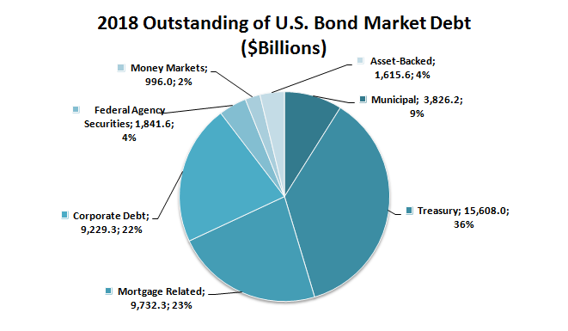
U.S. Bond Market
Notes:
美国国债少
中国债券市场发展落后

Slide 43
Mortgage-backed Market
每月归还贷款
出售资产抵押债券
出售房地产债务抵押证券CDO）
Prime
Alt-A
Sub
prime
次
级
抵
押
贷
款
公
司
投
资
银
行
对冲基金
保险公司
养老基金
银 行
房地产抵押债券支持证券（MBS）
提供住房贷款
提供贷款现金
提供资金
Notes:
1、重组现金流，构造证券化资产。
2、组建特设信托机构，实现真实出售，达到破产隔离。
3、完善交易结构，进行信用增级。
4、资产证券化的信用评级
5、安排证券销售，向发起人支付
6、挂牌上市交易及到期支付
“ALT-A”贷款的全称是“Alternative A”贷款，指的是介于优质抵押贷款（Prime Loan）和次级抵押贷款（Subprime Loan）二者之间的贷款，也被称为接近优级（Near-Prime），通常包括贷款信用分数在620~680分之间的借款人。它泛指那些信用记录不错或很好的人，但却缺少或完全没有固定收入、存款、资产等合法证明文件。最理想的申请对象是近期离婚的、企业家、个体户和依靠佣金做收入的群体。表面上看这类抵押贷款比次级贷款更安全，实际上，存在的潜在风险极大。
（按揭贷款市场大致可以分为三个层次，优质贷款市场(Prime Market)，“ALT-A”贷款市场，和次级贷款市场(Subprime Market)。优质贷款市场面向信用等级高(信用分数在660分以上)，收入稳定可靠，债务负担合理的优良客户，这些人原来主要是选用最为传统的30年或15年固定利率按揭贷款。次级市场是指信用分数低于620分，收入证明缺失，负债较重的人。而“ALT-A”贷款市场则是介于二者之间的庞大灰色地带，它既包括信用分数在620到660之间的主流阶层，又包括分数高于660的高信用度客户中的相当一部分人。 ）

Slide 44
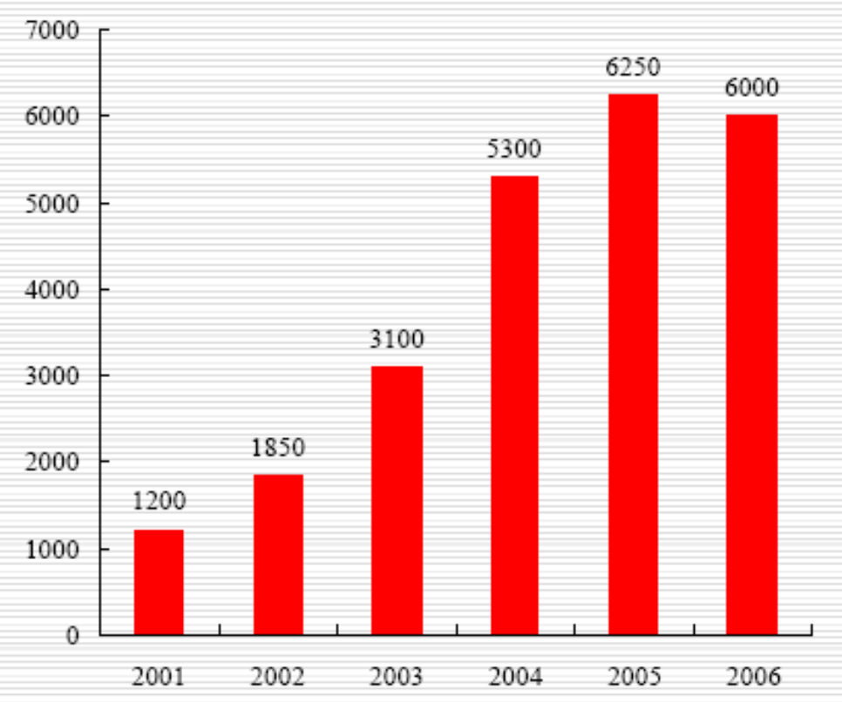
U.S Residential mortgage Market
Notes:
住房抵押贷款
单位, 亿USD
次贷占20%
http://baike.baidu.com/view/892564.htm
所谓次级房贷就是抵押贷款市场中的次优等抵押贷款，其与一般房贷最主要的不同点在于，这种贷款是提供给那些信用程度较差，及还款能力比较弱的购屋者，其利率也比一般抵押贷款高二至三个百分点。
正常情况下，这样的客户很难从银行贷款。前几年，美国楼市火热的时候，很多按揭公司或银行为扩张业务，介入次级房贷业务。银行是“嫌贫爱富”，针对次贷申请者，银行能收取更高的利率。从表面和微观看，这似乎合情合理，但从宏观仔细想，它已为危机埋下隐患。让买不起房的人支付更高的利息，房贷公司、银行不仅逼死买房人而且最终逼死自己。

Slide 45
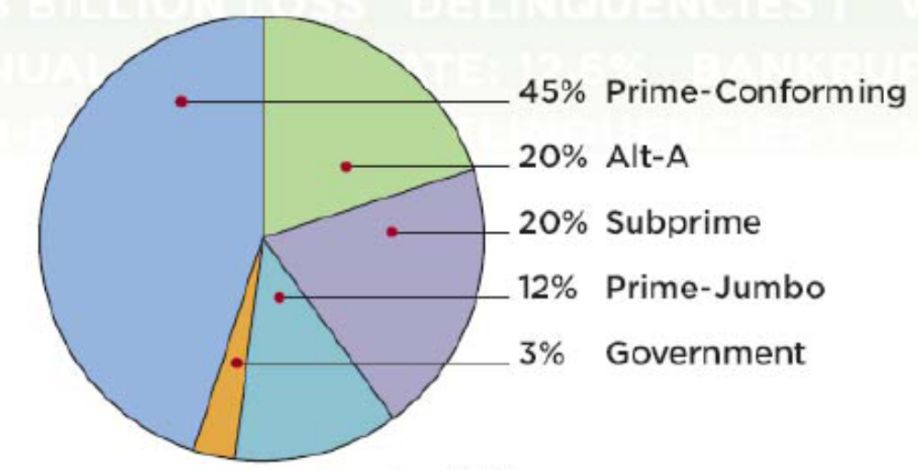
The Proportion of Mortgage Loan
Notes:
Prime -conforming
A sector of mortgage lending made up of loans to borrowers who are considered to be of a high credit quality, and where the dollar amount of the mortgage is equal to or less than the conforming loan limits set by the Office of Federal Housing Enterprise Oversight
What Does Alt-A Mean?
A classification of mortgages where the risk profile falls between prime and subprime. The borrowers behind these mortgages will typically have clean credit histories, but the mortgage itself will generally have some issues that increase its risk profile. These issues include higher loan-to-value and debt-to-income ratios or inadequate documentation of the borrower's income.
Jumbo Loan Mean?
A mortgage with a loan amount exceeding the conforming loan limits set by the Office of Federal Housing Enterprise Oversight (OFHEO), and therefore, not eligible to be purchased, guaranteed or securitized by Fannie Mae or Freddie Mac. OFHEO sets the conforming loan limit size on an annual basis.

Slide 46
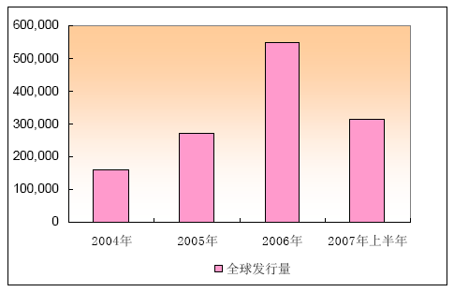
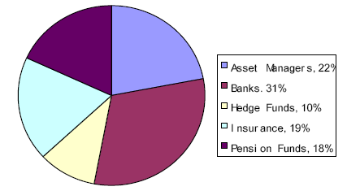
CDO 市场概况
根据IMF数据显示，银行，资产管理公司，保险公司，养老基金，对冲基金是CDO主要的投资机构。
持有结构的广泛和分散，是的这次次级债风波波及的机构范围相当大。

Slide 47
信贷标准宽松的次级抵押贷款
在房价只涨不跌的市场环境中，各种次贷公司不断涌入房地产抵押贷款市场；
贷款利率持续上涨使得借款人转向非传统抵押贷款， 以减轻还本付息的压力；
大量因信用记录不好或偿还能力较弱 而被银行拒绝提供优质抵押贷款的人，轻易的从次贷公司除申请到次级抵押贷款购买住房；
次贷产品：无本金贷款（Interest Only Loan），可调整利率贷款（ARM，Adjustable Rate Mortgage），选择性可调整利率贷款（Option ARMs）。
Notes:
ARM：可调整利率贷款
O-ARM：选择性可调整利率贷款
无本金；在还款的前几年，每月按揭支付非常低并且固定的数额，但是，很
多事情总是有但是，呵呵！等到过了一定时间后，贷款偿还金额自动发生重
新设定，还款的压力就会陡增。（228、327、525）
美国这种房贷被追捧的主要原因：1.人们认为房地产永远会上涨，至少在他们
认为合理的时间里会是这样。只要他们能及时将房地产出手，风险就是可以
控制的；,2.想当然的认为房地产上涨速度大于利息负担的增加速度。

Slide 48
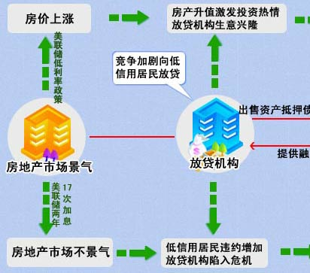
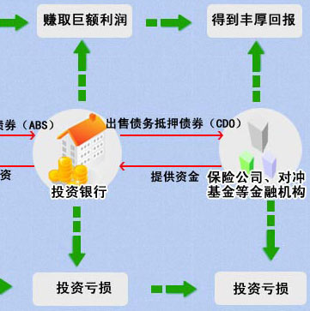
Sub Prime Crisis Process

Slide 49
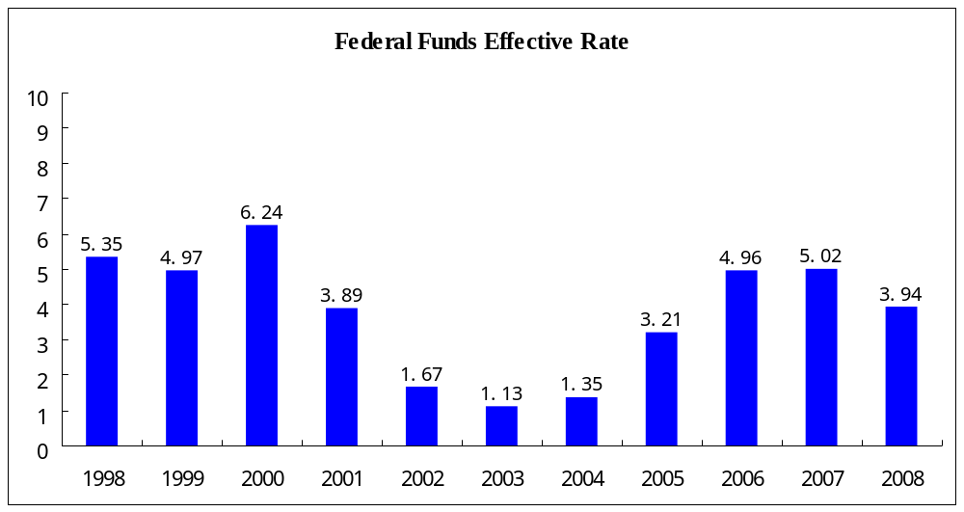
Federal Fund Interest Rate

Slide 50
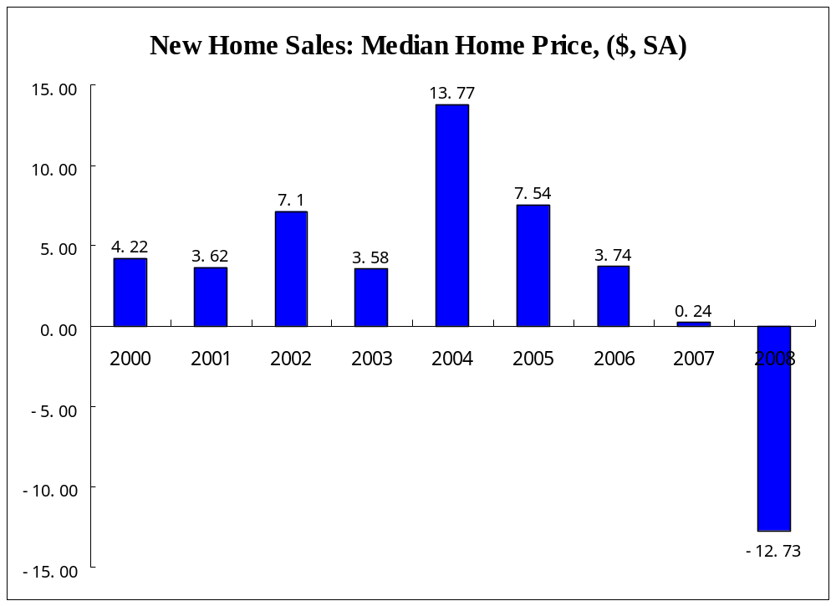
U.S. House Price Fall

Slide 51
美国经济衰退迹象明显
美国房地产市场衰退
  美国商务部公布的数据显示，今年1月份，美国新房销售量比前一个月下降2.8%，经季节调整按年率计算为58.8万套，是1995年2月以来的最低点。这是美国新房销售量连续第三个月下降。去年12月份和去年11月份，美国新房销售量分别下降了4%和13.1%。与去年同期相比，今年1月份新房销售量下降了33.9%。
  Moody‘s Economy.com的数据表明，全美国将有占总数10.3%的约880万个家庭的按揭面临负资产的风险，这一数字比一年前多了一倍以上，负资产按揭的价值总额约2.6万亿美元。
美国个人消费者支出下降
消费者信心指数下降

Slide 52
次级债危机损失评估
美国次级债规模1.3万亿美元，Alt-A贷款为1万亿美元，分别占美国住宅贷款总额的15％和11％。
在假设次级贷款违约以后最终发生损失的概率为45％，Alt-A的违约概率为35％，则整个次级贷款的预估损失是1450亿美元（13000·25％·45％）；Alt-A的预估损失是250亿美元（1000·7％·35％）；合计为1700亿美元。这个数字大概相当于美国2006年GDP的1.3％。
随着贷款损失的发生和住宅价格的下跌，MBS的估值损失大约为650亿美元；ABS CDO估值损失为1200－1300亿美元，合计约为2000亿美元，占GDP1.5％左右。

Slide 53
对美国和全球经济的影响
2008 年全球经济将下滑20%(IMF报告)
  美国经济减速明显，07年3Q美国经济增长实现3.9%, 07年4Q美国经济增长大幅下滑至0.6%.
  IMF估计美国08年经济增长1.5%.
  在美国经济减速同时，西方发达国家全体呈现减速，欧盟将GDP 增长从2007 年2.6%下滑至2008 年1.6%，日本从07 年1.9%下滑至08 年1.5%。

Slide 54
Questions
Who will invest in fixed income market?
When an investor purchase a mortgage-backed securities, what kinds of risk will she/he be exposed?
What is six sector in Bond market from issuer perspective?

Slide 55
Session 3 Fixed Income Basic Pricing

Slide 56
Agenda
Term Structure of yield curve
Spot Curve
Bond Pricing Using Spot Curve
Measures of Bond Price Volatility
  Duration
Notes:
利率的期限结构：收益率与到期日（期限）之间的关系
利率期限结构对证券估价非常重要

Slide 57
The Yield of a Bond
When you invest in bond, how to know your return?
Two basic yield indicator: Current Yield ; yield to maturity
Notes:
Yield is the annualized return on investing in a bond, considering both coupon payments and redemption value (normally the face value)
当期收益率(Current Yield)当期收益率又称直接收益率
到期收益率(Yield to Maturity，YTM)又称最终收益率

Slide 58
Yield of bonds: Current Yield
Current Yield calculates the percentage return that the annual coupon payment provides the investor.
The general definition of yield is the return an investor will receive by holding a bond to maturity.
Current Yield = Annual Interest Paid/ Market Price *100%
If you purchased a bond with a par value of %100 for $95.92 and it paid a coupon rate of 5%, the current yield is
(0.05*$100)
= * 100% = 5.21%
%95.92
Notes:
当期收益

Slide 59
Yield of bonds: Yield To maturity
Yield to Maturity is the return that the investor will receive of all cash flows at a constant interest rate until the bond matures.
Cashflow1 Cashflow2 Last C
Bond Price = + +…+
(1+yield)^1 (1+yield)^2 (1+yield)^n
The yield to maturity is a interest rate that must be calculated through trial and error.
Notes:
到期收益率，内在收益率，以恒定的利率资产增长
计算方式：已知所有现金流，模拟试错

Slide 60
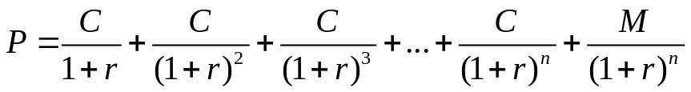
Bonds pricing 1: Use YTM
An estimate of the expected cash flow
  Periodic coupon interest payments to maturity date
  The par (or maturity) value at maturity
An estimate of the appropriate required yield
  The required yield is determined by investigating the yield offered on comparable bonds in market.
The formula:
  P is the bond price
  C is the periodic coupon payment
  N is the number of years to maturity
  M is the (face value) payment at maturity
  r is the “risk-adjusted discount rate” (or yield to maturity, IRR)
Notes:
债券定价
金融产品定价的原则：未来现金流折现
现金流，

Slide 61
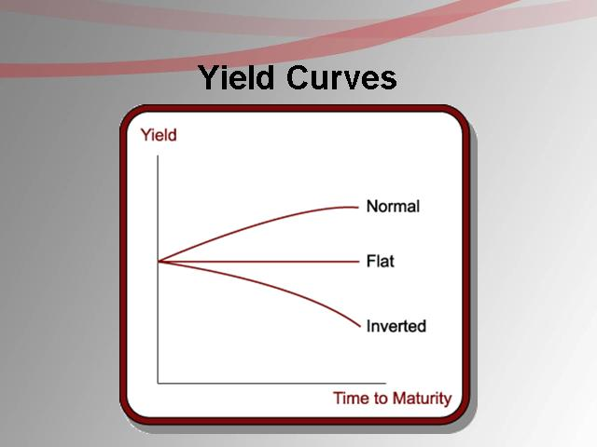
Notes:
收益率曲线
描述具有相同的信用质量（国债，信誉高，流动性足）但期限不同的债券之间的收益率关系的图形
按不同期限下的收益率画点后连线，会形成什么形状？
Normal:向上倾斜，收益益随期限稳步上升，正常的收益率曲线
Flat:水平
Inverted:向下倾斜或倒转，收益率随期限增加而下降

Slide 62
Why there are different Yield curve slop?
Pure expectation theory
  Liquidity preference
  Preferred habitat
Biased expectation theory
  Liquidity preference
    Long term rate: expectation + premium
    Liquidity premium directly related to maturity
  Preferred habitat
    Long term rate: expectation + premium
    premium does not relates to maturity, but to preference
    Market segment theory
Notes:
解释这三种情况的主要理论有两个：纯预期理论，有偏预期理论
纯预期理论
主张，除了预期的未来短期利率外，没有其他系统性因素影响远期利率；收益率曲线的样子完全取决于市场对未来收益率的预期，而这种预期会影响市场参与者的投资决策，从而使利率往预期方向发展
如上扬曲线，市场预期未来收益率上升，长期债券购买者将不再愿意购买长期债券，反而采用短期债务工具做轮转，长期债券的需求下降，导致价格下降收益率上升；借款者则会选择现在长期借款以锁定较低的利率，因为根据预期，以后借款会更贵。
纯预期理论的缺陷在于：没有考虑与债券投资密切联系的风险。风险随债券期限的延长而增加。
有偏预期天理论
主张：存在其他影响因素
流动性理论：人性厌恶不确定性，因时间长带来的不确定性（利率波动），因此需要足够的补偿，投资者才愿意购买长期债券
流动性溢价，期限越长，溢价应该越大。
因此，向上曲线是非常正常的，即使未来利率持平甚至下降
偏好理论：利率不一定跟期限有关，市场参与者对特定期限债券供需不平衡导致
市场分割理论：投资者因其自身的资产负债结构，偏好特定期限的债券；贷款人限定在特定的期限品种上（资产/负债管理约束）
For example, pension funds prefer staying invested in longer-term Treasury bonds (TLT) to match their assets to long-term liabilities they have on their books. On the other hand, commercial banks and finance companies have short-term liabilities, so they prefer to stay invested in short-term securities like T-bills (BIL). The demand and supply in each of the maturity segments determine the yield in that segment. Property and casual insurance companies have uncertain liabilities in terms of timing and value, so they prefer to stay invested in medium-term bonds (IEF).

Slide 63
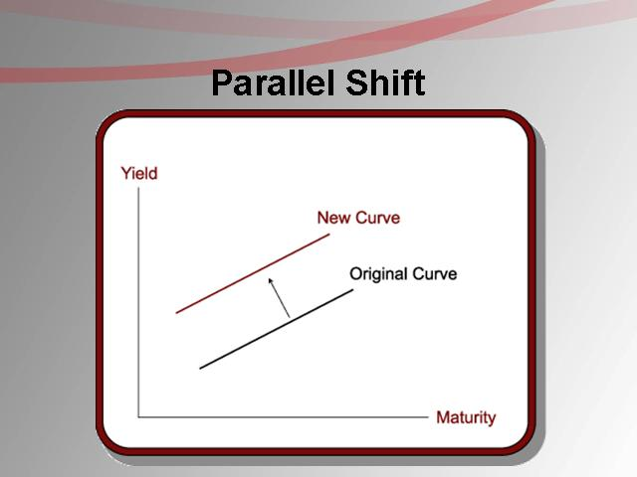
Yield Curve Shift (Parallel)
Notes:
Yields on bonds don’t remain constant.
When they change by the same magnitude across maturities, we call the change a “parallel shift.”
When they change in different magnitudes across maturities, we call the change a “non-parallel twist or shift.”

Slide 64
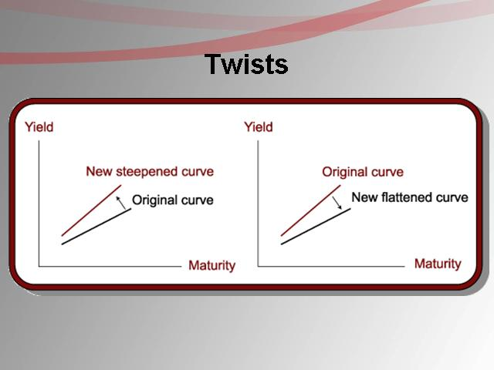
Yield Curve shift (Twists)
Notes:
When the different between yields of short-term (BIL) and long-term (TLT) bonds decrease, we call the change a “flattening of the curve.”
On the contrary, when the difference increases, we call it a “steepening of the curve.”
In flattening and steepening, the yields across maturities don’t change by equal magnitudes.

Slide 65
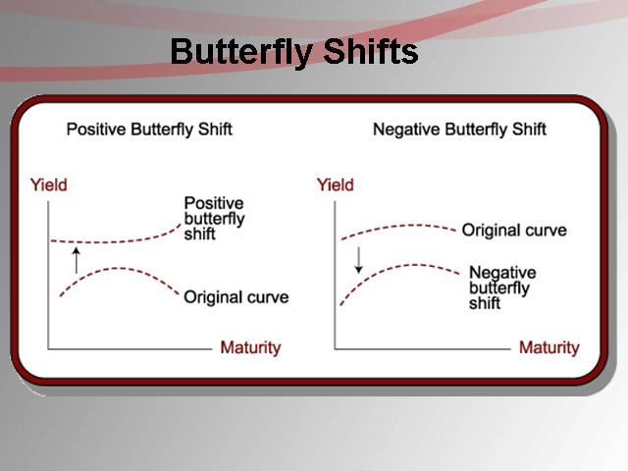
Yield Curve Shifts (Butterfly)
Notes:
Another type of shift is the change in the curvature of the yield curve. In butterfly shifts, the magnitude of change in the yield of short-term (BIL) and long-term (TLT) bonds is higher or lower than the magnitude of change for intermediate-term (IEF) bonds.
When the short- and long-term yields increase by greater magnitude than intermediate-term yields, we call the change a “positive butterfly yield.” When short- and long-term yields decrease by a greater magnitude than intermediate-term yields, we call the change a “negative butterfly shift.”
The shifts and twists also affect investment-grade corporate bonds (LQD) and high-yield bonds (HYG), as the yield on these bonds is nothing but the yield on corresponding Treasury bonds plus a credit spread to compensate for the credit risk associated with these bonds.
While the yield curve is normally upward-sloping, the shifts and twists cause the yield curve to take different shapes under special conditions. In the next parts of this series, we’ll discuss the shapes a yield curve can take and the implications for fixed income and ETF investors.

Slide 66
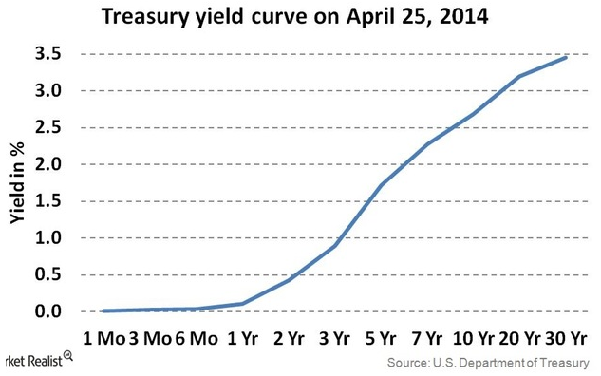
Upward sloping yield curve
Notes:
In normal conditions, the yield curve is upward-sloping. As bonds pay only interest (the coupon) until maturity and pay face value at maturity, investors take longer to recover their principal. The longer time to recover the principal leads to a higher risk to bondholders, as the bonds become more susceptible to interest rate changes than shorter-term bonds. The added risk prompts investors to seek higher returns from longer-term bonds, leading to an upward-sloping yield curve, just like the current Treasury yield curve.
The Fed has maintained an extremely low short-term interest rate regimen since 2008 to boost consumption, investments, and economic growth. While short-term rates are low, yields are exhibiting an increasing trend with maturity. So yields on longer-term Treasuries (TLT) are higher than intermediate-term (IEF) yields, which are in turn greater than yields on T-bills (BIL).
The normal upward-sloping yield curve follows the “Liquidity Preference Theory,” which suggests that investors wish to be compensated for holding longer-term securities.

Slide 67
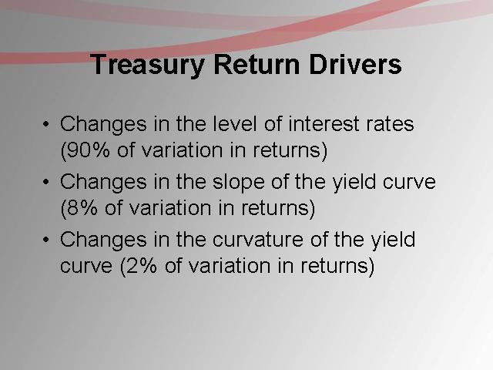
Why Yield Curve important?
1. Basis for Spot Rate Curve
2. Treasury Return Drives
Notes:
Why Spot Rates are so important? Suppose that the 7-year Treasury security you are interested in pricinghas a coupon rate of 9%.
If you look at the universe of 7-year Treasury securities, you will find that there are several different issues, each with different coupon rates. Which one is correct?
→None of them are correct.
In order toaccurately price a fixed-income security, you need a spot rate for each cash flow. Thus, to value your 7-year 9% bond, you will need unique spot rates for each of the 14 coupon payments and a spot rate for the return of principal. In order to obtain all the necessary spot rates, you will need to construct a theoretical spot rate curve for Treasury securities.
Factors that drive U.S. Treasury security returns
Three Factors :
1. Changes in the level of interest rates(parallel shiftsin the yield curve).
2.Changes in the slope of the yield curve(twistsin the yield curve).
3.Changes in the curvature of the yield curve(butterfly shifts).

Slide 68
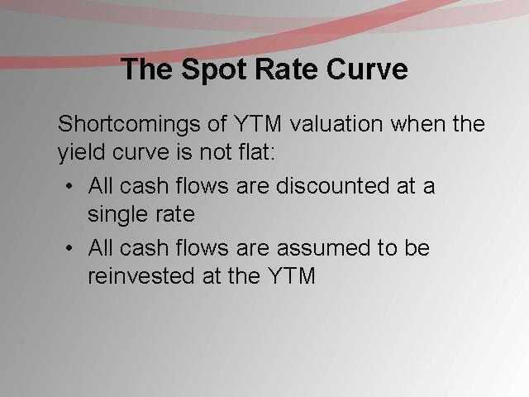
Spot Rate
Spot rate is the interest rate that you actually receive when investing in zero coupon bond.
Notes:
即期利率

Slide 69
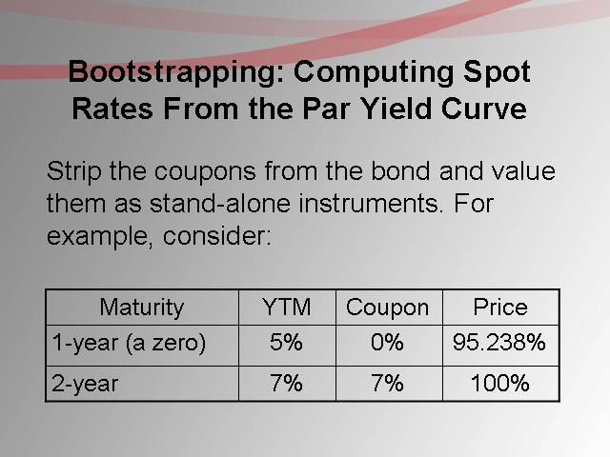
The Derivation of spot rate curve

Slide 70
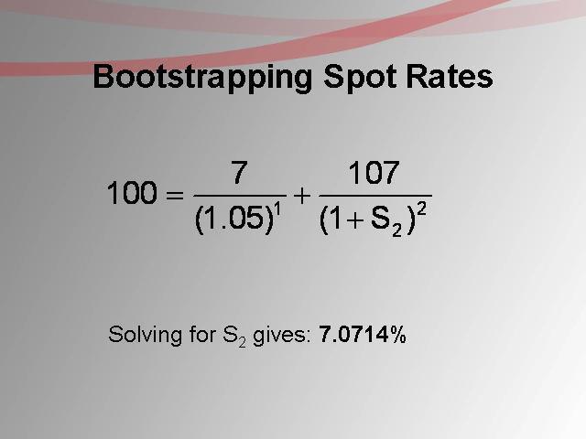

Slide 71
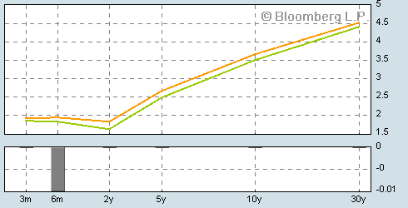
Spot rate Curve (illustrative only)

Slide 72
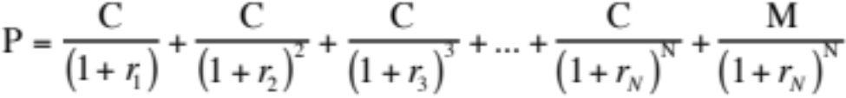
Bond Pricing 2: Use Spot Rate
You can still calculate a YTM (y)
But it is a complex average of spot rates
Here, each spot rate r_{n} is the discount rate for a cash flow in year n that can be locked in today
E.g., r₃ (3-year spot rate) is the rate the market uses to value a single payment three years from today

Slide 73

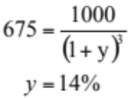
Zero coupon bond example
Price of 3-year zero coupon bond with face value = 1000
  Spot rates: r₁=10%, r₂=12%, r₃=14%
  Yield-to-Maturity

Slide 74

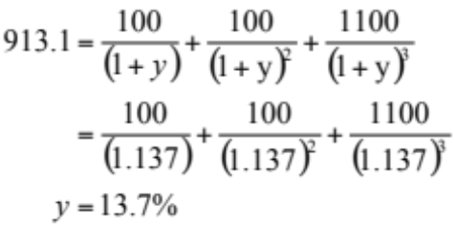
Coupon bond example
Take a 3-year 10% coupon bond with face value = 1000, assuming annual coupon payments:
  Spot rates: r₁=10%, r₂=12%, r₃=14%
  Yield-to-Maturity

Slide 75
Forward Rates
Forward rates of interest are implicit in the term structure of interest rates
t = 0 1 2 3 4…
Note the notation: ₃f₄ means “the forward rate from period 3 to period 4.”
When the beginning subscript is omitted, it is understood that the forward rate is for one period only: ₃f₄ = f₄ .
r₁
₁f₂
r₂
₂f₃
r₃
₃f₄
Notes:
投资期为2年的投资者有以下两种选择：
选择1：购买2年期的国库券；
选择2：购买1年期的国库券，待到期后，再购买另外一只1年期的国库券。
怎么抉择？
假如他知道1年之后的1年期国库券的即期利率，就可选择综合收益率更高的方案。1Y2Y即期利率10% ，1年后的1年即期（债券市场大牛）20%。无风险套利
但是，市场上不会存在无风险套利机会。
这个例子让大家熟悉远期利率的含义，可由这种逻辑推算出远期利率

Slide 76
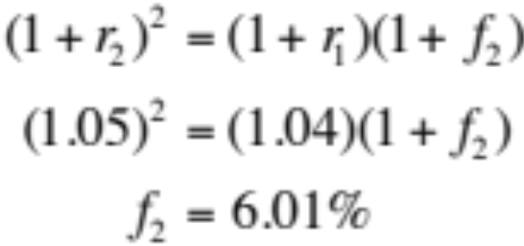
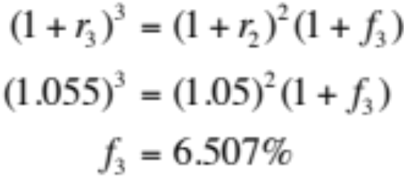
Example: Forward rates
What one-year forward rates are implied by the following spot rates?
Maturity Year | Spot Rate (r_{t}) | Forward Rate (f_{t})
1 | 4.0% | –
2 | 5.0% | 6.01%
3 | 5.5% | 6.507%

Slide 77
Price-Yield Relationship
The price changes in the opposite direction from the change in the required yield. This shape is referred to as convex.
Price
Yield

Slide 78
Relation between coupon,yield and price
Coupon rate < required yield -> price <par (discount bond)
Coupon rate = required yield -> price = par
Coupon rate > required yield -> price > par (premium bond)

Slide 79
Relationship between Bond price and Time if interest rates are unchanged
The price will move to par value at the maturity date.
For example: a 20-year 10% coupon bond.
Year | Price of Discount Bond Selling to Yield 12% | Price of Premium Bond Selling to Yield 7.8%
20 | 849.54 | 1,221.00
15 | 862.35 | 1,192.54
10 | 885.30 | 1,150.83
5 | 926.40 | 1,089.67
3 | 950.83 | 1,057.85
2 | 965.35 | 1,040.02
1 | 981.67 | 1,020.78
0 | 1,000.00 | 1,000.00
Notes:
溢价债券，折价债券，随着时间接近到期日，债券价格接近面值

Slide 80
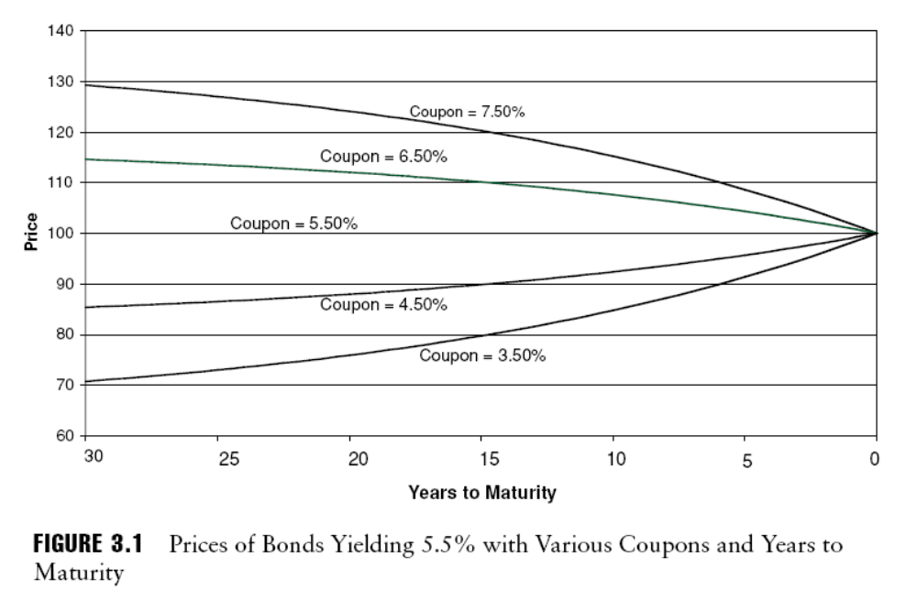
Relationship between Bond price and Time if interest rates are unchanged

Slide 81
Measures of Bond Price Volatility
Duration is a measure of price sensitivity to interest rates—that is, how much a bond’s price changes in response to a change in interest rates.
Macaulay duration
Modified duration
Effective duration
Notes:
债券价值的变化与利率变化是反向的。如果利率上升，债券多头的价值将减少，造成损失。空头相反。因此，利率的波动会对投资人的收益产生不确定性，市场风险。
风险量化方法，利率反变动后对头寸的价值做精确估计。
两种衡量利率风险的方法：完全估计法（情景分析法）和久期凸性法
麦考利久期
修正久期
有效久期

Slide 82
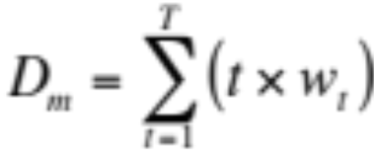
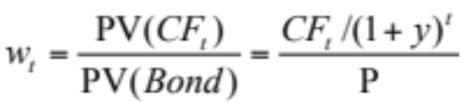
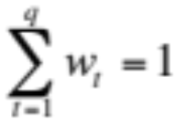
I. (Macaulay) duration
Weighted average term to maturity
  Measure of average maturity of the bond’s promised cash flows
Duration formula:
where:
t is measured in years
Notes:
Macaulay duration 麦考利久期
债券承诺现金流的平均到期时间

Slide 83
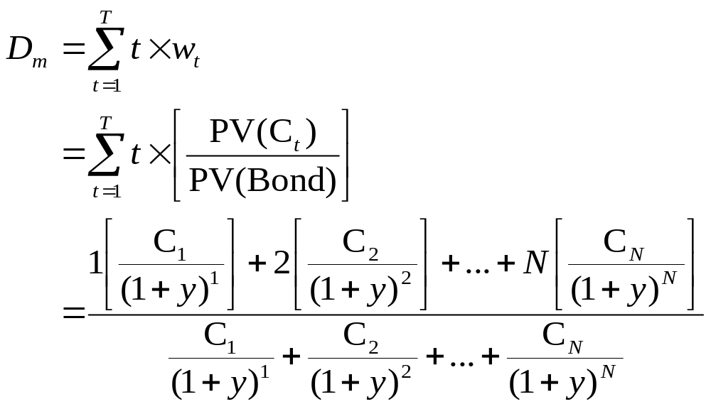
Duration - The expanded equation
Duration is shorter than maturity for all bonds except zero coupon bonds
Duration of a zero-coupon bond is equal to its maturity

Slide 84
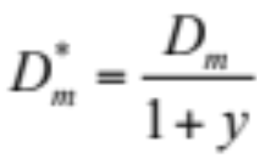
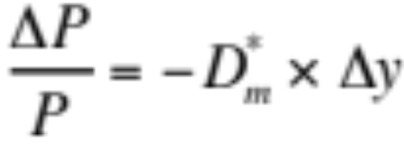
II. Modified duration (D*_{m})
  Direct measure of price sensitivity to interest rate changes
  Can be used to estimate percentage price volatility of a bond
Notes:
债券价格对利率变化的敏感性

Slide 85
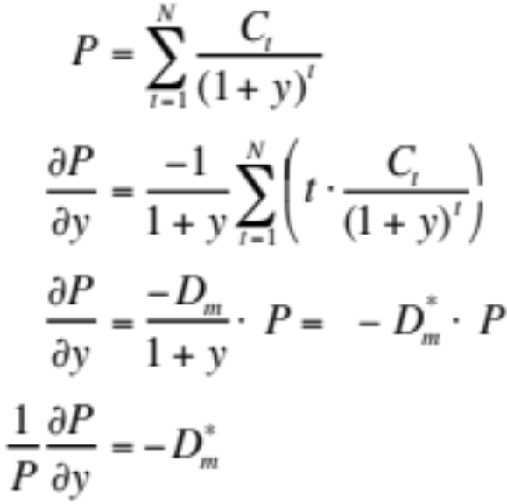

Derivation of modified duration
So D*_{m} measures the sensitivity of the % change in bond price to changes in yield

Slide 86
III. An example
Compare the price sensitivities of:
  Two-year 8% coupon bond with duration of 1.8853 years
  Zero-coupon bond with maturity AND duration of 1.8853 years
Semiannual yield = 5%
Suppose yield increases by 1 basis point to 5.01%
Upshot: Equal duration assets are equally sensitive to interest rate movements
 | Original Price | New Price | % Change
Coupon bond | 964.54 | 964.19 | -.0189
Zero bond | 831.96 | 831.61 | -.0189
Notes:
应用
更方便

Slide 87
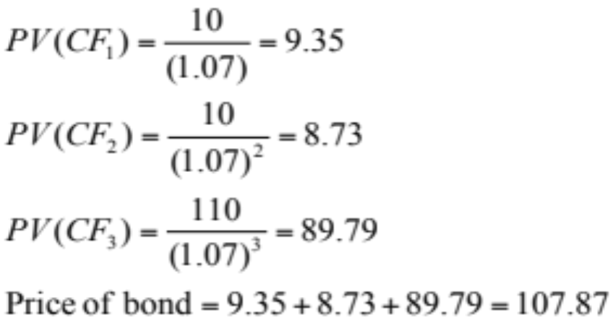
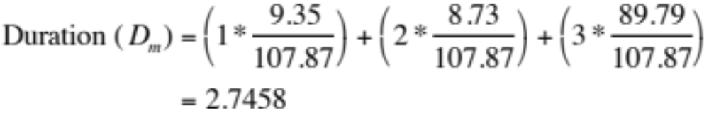
Another example
Consider a 3-year 10% coupon bond selling at $107.87 to yield 7%. Coupon payments are made annually.

Slide 88
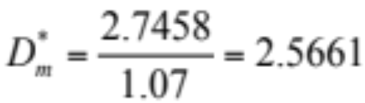
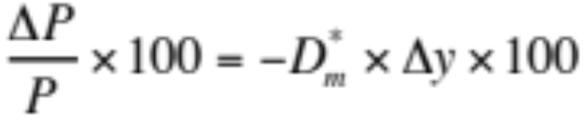
Another example – page 2
Modified duration of this bond:
If yields increase to 7.10%, how does the bond price change?
The percentage price change of this bond is given by:
= –2.5661 × .0010 × 100
= –.2566

Slide 89
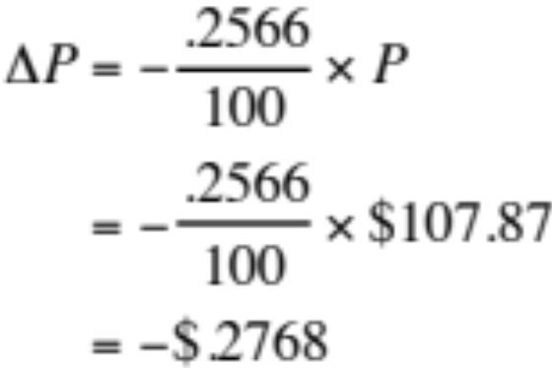
Another example – page 3
What is the predicted change in dollar terms?
New predicted price: $107.87 – .2768 = $107.5932
Actual dollar price (using PV equation): $107.5966

Slide 90
Duration
Bonds with a high duration will have a higher price fluctuation than bonds with a low duration.
Three factors determine how sensitive a bond’s price is to changes in interest rate, term to maturity, coupon rate and yield to maturity.
If term to maturity and a bond’s price remain constant, the higher the coupon, the lower the duration.
The bond with a longer term to maturity has higher duration and with a shorter term to maturity have a lower duration.
A bond with a high yield to maturity has lower duration and with a low yield to maturity has a higher duration.
Notes:
久期越大，价格波动性越高
三因素决定价格对利率的敏感性：到期期限，息票率，到期收益率
息票越高，久期越小
期限越长，久期越大
收益率越高，久期越小

Slide 91
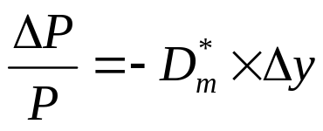
Summary: Steps for finding the predicted price change
Step 1: Find Macaulay duration of bond.
Step 2: Find modified duration of bond.
Step 3: Recall that when interest rates change, the change in a bond’s price can be related to the change in yield according to the rule:
  Find percentage price change of bond
  Find predicted dollar price change in bond
  Add predicted dollar price change to original price of bond
  ⇒ Predicted new price of bond

Slide 92
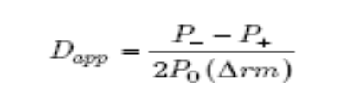
Effective Duration
The modified duration of a bond measures its price sensitivity to a change in yield. It assumes that no change in expected cash flows will result from a change in market interest rates and is thus inappropriate as a measure of the interest rate risk borne by a mortgage-backed bond, whose cash flows are affected by rate changes because of the prepayment effect.
A more accurate measure of mortgage-based bonds’ interest rate sensitivity is effective duration. Effective duration is based on approximate duration.
Where
P0 = the initial price of the bond
Δrm = the change in the yield of the bond
P– = the estimated price of the bond if the yield decreases by Δrm
P+ = the estimated price of the bond if the yield increases by Δrm
P– and P+ are obtained using a valuation model—such as a static cash flow model, a binomial model, or a simulation model—that incorporates the effect of a change in interest rates on the expected cash flows.
Notes:
修正久期假设利率变动未来现金流无变动，然而MBS提前还款影响，需要用有效久期

Slide 93
IV. Why is duration a big deal?
Simple summary statistic of effective average maturity
Measures sensitivity of bond price to interest rate changes
  Measure of bond price volatility
  Measure of interest-rate risk
Useful in the management of risk
  You can match the duration of assets and liabilities
  Or hedge the interest rate sensitivity of an investment

Slide 94
Session 4 Fixed Income Trading

Slide 95
Fixed Income Trading
Unregulated Market
Over the Counter
Institutional Dealers
Government Bonds / Treasury Bills
Fixed Income Mutual Fund

Slide 96
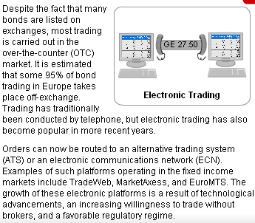
Bond Markets includes
1. OTC Market
An ATS is an electronic system that brings together potential buyers and sellers of securities and may therefore disintermediate the traditional role of brokers in securities trading.
An ECN is an ATS in the US that has registered with the Securities and Exchange Commission (SEC) as a broker/dealer. Subscribers to ECNs can place trades directly with the ECN and include institutional investors, broker/dealers, and market makers.
Notes:
债券的二级市场流通市场：OTC，exchange
尽管有大量的债券在交易所交易，OTC是主场，（europe95%未通过交易所）
传统的交易通过电话，而电子化交易慢慢取代
另类交易系统（ATS）电子通信网络（ECN）

Slide 97
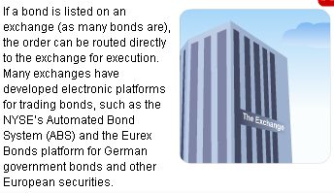
Bond Markets includes
2. Stock Exchanges
Notes:
撮合交易
交易所都有电子化的平台做债券交易

Slide 98
Trading for Fixed Income Securities
For treasury securities, the secondary market is an over-the-counter market in which a group of U.S. government dealers offer continuous bid and ask prices on outstanding treasuries.
Treasury Securities:
  On-the-run issues : newly auctioned treasury securities, bid-offer spread are typically 1/32 to 2/32.
  Off-the-run issues : the seasoned issues in previous auctions.
Treasury bills (T-Bills) are auctioned by the U.S. Treasury at periodic intervals. T-bills are among the most liquid and nominally riskless securities.
Notes:
Treasury, OTC市场
基差小
TB 拍卖

Slide 99
Corporate bond trading
For corporation bonds, the principal secondary market is the over-the-counter market. There is some trading on exchanges
The price quota of investment-grad corporate bond trading is based on the benchmark plus spread.
The price quota of high yield corporate bond trading is based on price.
Notes:
公司债券， 主要为OTC，也有一些在交易所
投资级债券定价：基准利率+基差，风险较基准高
高收益债券： 市价

Slide 100
Trading for China Fixed Income Securities
CFETS – China Foreign Exchange Trading System
交易中心于1994年4月18日成立，是中国人民银行总行直属事业单位。主要职能是：提供全国银行间外汇、人民币同业拆借、债券以及汇率和利率衍生品交易系统并组织交易；提供银行间市场清算、信息和监管等服务；开展经人民银行批准的其它业务。
FX
Bond
Derivative
Commercial
Papers
Lending
( RMB )
CFETS / NIFC, part of PBC, the central bank
(Market under PBC)
Central Bank: PBC / SAFE
(State Administration of Foreign Exchange)

Slide 101
Product Structure in China Interbank Market
Interbank spot market
Interbank derivatives market
FX market
Bond market
Money market
Exchange rate derivatives
Interest rate derivatives
Spot FX
FX Pairs trading
Cash bond trading
ABS trading
Credit lending
Bond Repo
FX forward
RMB/FX swap
Bond forward
Interest rate swap

Slide 102
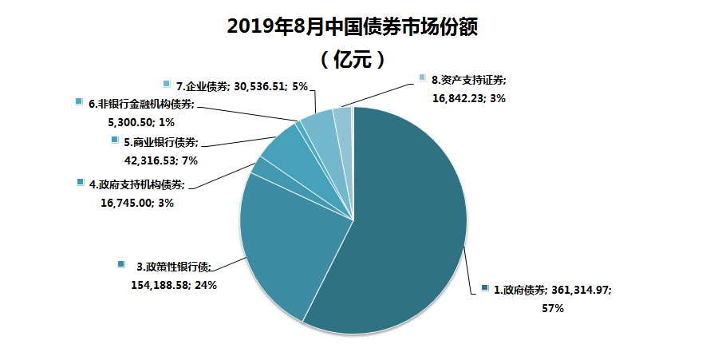
China Bond Market
Notes:
中美公司债券结构比较，中国国债多

Slide 103
RMB Interbank borrowing and lending
Trading Mode: Negotiation; Bilateral clearing
Trading Participants
The participants are the PBC-approved financial institutions with independent legal identity, including banks, financial companies, and those foreign financial institutions that are approved by the PBC to handle RMB business.
Trading Mode
Negotiation mode
Trading members entry negotiation quotation to all members or directional member. The member can choose a quotation to formatted or unformatted negotiation with counterpart. When counter party send a confirmation response to Host party quotation, the deal is confirmed and Transaction note is printed.
Trading Instruments
Trading parties can agree on any maturities of up to one year. The standard day include overnight, 7-day, 14-day, 21-day, 1-month, 2-month, 3-month, 4-month, 6-month, 9-month and 1-year.
Clearing Mode
Trading members bilateral gross clearing directly with transaction note though PBC payment system. The clearing speed is T+0 or T+1.
CFETS RMB Interbank
Borrowing and Lending Market
Select a quotation to negotiate
Trading
Member A
① Entry negotiation
quotation
②
Trading
Member B
③
Formatted and unformatted negotiation
via CFETS trading system
④ Print transaction note
④ Print transaction note
④
PBOC Limit,
Single Limit,
Settlement Limit,
Trading Limit,
Counterparty Limit
⑤
CFETS
Middle and Back office
Clearing trace and prompting function
Clearing trace and prompting function
Bilateral gross clearing
with transaction note
PBC
Payment System
Bilateral gross clearing
with transaction note
Unformatted negotiation will be provided in CFETS new generation RMB trading system

Slide 104
RMB Bond/Repo/Bond Forward Trading
Trading Mode: Negotiation; Bilateral Settlement and Clearing
Trading Participants
All institutions qualified for bond trading can participate in the market, including bank, insurance, fund, security and foreign financial companies.
Trading Mode
In negotiation mode trading members list two-way/one-way quotation to all members or directional members. Formatted negotiation is that members use system formatted form to discuss quotation. Unformatted negotiation is that members discuss quotation though chat option, and the agreement trades can be enter in formatted negotiation functions.
Trading Instruments
Cash bond,bond repo, buyout repo, bond forward. Cash bond includes government bonds, corporate bond, asset-backed securities.
Settlement and Clearing Mode
The bilateral clearing mode used could be either gross principle delivery or netted delivery. The system provide three clearing modes of “payment after delivery”, “delivery after payment” and “delivery vs. payment”. clearing speed is T+0 or T+1.
② Click a quotation to negotiate
①
②
Entry two-way/one-way quotation
CFETS RMB
Trading System
Bank B
Bank A
③
Formatted and unformatted negotiation
via CFETS trading system
④ Print transaction note
④ Print transaction note
CFETS
Middle and Back office
(Centralled Margin Management)
Pay margin for buyout repo
and bond forward trading
Pay margin for buyout repo
And bond forward trading
⑤
Bond custodian settlement
China Government
Securities Depository Trust &Clearing Co. Ltd
⑤
Bond custodian settlement
Bilateral gross clearing
with transaction note
⑥
Bilateral gross clearing
with transaction note
PBC
Payment System
⑥
Unformatted negotiation will be provided in CFETS new generation RMB trading system

Slide 105
Summary and Review
Fixed Income Securities
Fixed Income Market
Fixed Income Trading

Slide 106
Quiz
1. A coupon bond:
  A. always sells at par.
  B. can always be converted into a specific number of shares of common stock in the issuing company.
  C. pays interest on a regular basis (typically semi-annually).
  D. does not pay intersest on a regular basis, but pays a lump sum at maturity.
2. If a bond's coupon is greater than the prevailing market rate on new issues, the bond is called a:
  A. par bond.
  B. term bond.
  C. premium bond.
  D. discount bond.
3.A 1-year, $1,000 face value zero-coupon bond is priced to yield a return of 7.50 percent compounded semi-annually. What is the bond’s price?

Slide 107
Quiz
4. Consider a bond that pays an annual coupon of 5 percent and that has three years remaining until maturity. Suppose the term structure of interest rates is flat at 6 percent. How much does the bond price change if the interest rate shifts down by 1 percent instantaneously.?
5. A bond has the following characteristics:
  A Macaulay duration of 18 years
  Maturity of 30 years
  Modified duration of 16.9 years
  Current yield to maturity is 6.5 percent
If the market interest rate decrease by 0.75 percent, what will be the percentage change in the bond's price?

Slide 108
推荐教材或主要参考书
1.
Name:债券市场 分析和策略
Author: Frank J.Fabozzi
Publisher: 北京大学出版社
Language: English
Date: 2006-1
ISBN: 7-301-09657-7
2.
Name: 固定收入证券市场及其衍生产品
Author:Suresh M. Sundaresan
Publisher:北京大学出版社
Language: English
Date:
ISBN: 7-301-05963-9

Slide 109
The useful websites
Http://www.bondmarkets.com
  The Bond Market Association website contains very useful data concerning fixed-income markets, research reports, market practices, and regulator developments.
Http://www.bloomberg.com
  Excellent websites for financial news, fixed income data including yield curve, stock quotes, and interest rates.
Http://www.chinabond.com.cn
  China bond market website contain lots of China treasury bond, and corporate bond market data, research reports and regulator information.

